Slide 1



  G H RAISONI COLLEGE OF ENGINEERING AND MANAGEMENT
(Approved by AICTE, New Delhi and Recognized by DTE, Maharashtra)
An Autonomous Institute Affiliated to Rashtrasant Tukadoji Maharaj Nagpur University, Nagpur
Accredited by NAAC with A+ Grade
Department of Computer Science and Engineering
Progress Project Seminar
Of Minor Project under Course Category Community Engagement Project (CEP)
(B. Tech 3rd Semester)
On
Department Monitoring & Information System
Guide:
Mrs. Priyanka Gonnade
Assistant Professor
Name of Projectees
Vivek Ramteke Yogeshwar Javanjal Yash Pandey
Yash Selokar Yash Pawar
Session 2025-2026

Slide 2

Contents
Introduction
Literature Survey
Objectives of the Project
Flow chart/Block Diagram
Mentor’s Suggestion
Innovative Work
Work Done(till date)
Result & Discussion(till date)
Work plan
References

Slide 3


Introduction
DIMS is a digital platform for managing and monitoring departmental activities in a college.
A Smart Solution for Department Administration.
It improves efficiency, transparency, and academic oversight.
This is an project about giving an Information of Teacher Availablity and the lab reports and activites.
Introduction / background about the project :
DIMS (Departmental Information Management System) is a smart digital platform developed to streamline and modernize the management processes within college departments.
DIMS addresses these challenges by offering a centralized system for managing faculty avaliabllity, notices, Lab reports and activities of club and departmental events .
The project was conceptualized to support Admin to see the reports and availability of Teacher, reduce administrative workload, and improve transparency and efficiency in department operations. Built with scalability and ease-of-use in mind, DIMS aligns with the vision of smart department and tech-driven management.

Slide 4
Literature Survey
Sr. No. | Paper Title and its Author | Details of Publication | Findings
1 | Development of a Comprehensive College Management System - Vipul V. Kulkarni, Atharv A. Patankar, Sumedh G. Kamble, Mahamadjaki | International Research Journal of Engineering and Technology Vol: 12, 03 Mar 2025 | Enhances communication and transparency in university departments.
2 | College Management System – Aditya Shelar, Sudarshan Sawant, Abhishek Pacharne, Sahil Tike, Prof. Dipali M. Mane | International Journal of Advanced Research in Science, Communication and Technology (IJARSCT) Vol 3, Issue 5, May 2023 | Aims at practical and user-friendly departmental management.
3 | Smart Campus Surveillance and Guidance System - Prof. Sabyasachi Chakraborty | International Organization of Scientific Research Journal of Computer Engineering, August 2023 | Includes feedback/SMS events; lacks assignment and marks modules.
4 | College Management System For College – Vaishnavi Patel, Sakshi Bhagwat, Shreya Ashtikar, Sakshi Kumbhare | International Research Journal of Modernization in Engineering Technology and ScienceVol:05,04 April-2023 | Focus on school functions; lacks library module.
5 | Online Attendance and Feedback System – Kartiki Datarkar | IJCSMC, Vol. 5, Issue 4, April 2016 | Tracks attendance and feedback; good for monitoring but limited in scope.

Slide 5
Objectives of the Project
Objective of the Project :
Digitalize Departmental Operations
Streamline Lab Tasks
Improve Data Management
Support Decision-Making
Ensure Role-Based Access
Promote Transparency and Accountability

Slide 6
Block Diagram
HOD
TEACHERS
STATUS
IN LECTURE
LEAVE
AVAILABLE
CLASS ROOM
ROOM NO

Slide 7
BLOCK DIAGRAM
LAB SECTION
LAB INFO
Reports
INCHARGE INFO

Slide 8
BLOCK DIAGRAM
HOD SECTION
Add \DeleteTeacher
Lab Reports
Teacher’s Status

Slide 9

Mentor’s Suggestion
Mentor’s Suggestion (if any)
Lab Reports
Implementation comment:
The feature to display lab components that need repair has been implemented in the app

Slide 10
Innovative Work
Innovative Work :
Added lab-incharge management & report generation.
Proposed analytics for better decision-making
Integrated role-based access with real-time dashboards.
Gives control to higher authority

Slide 11
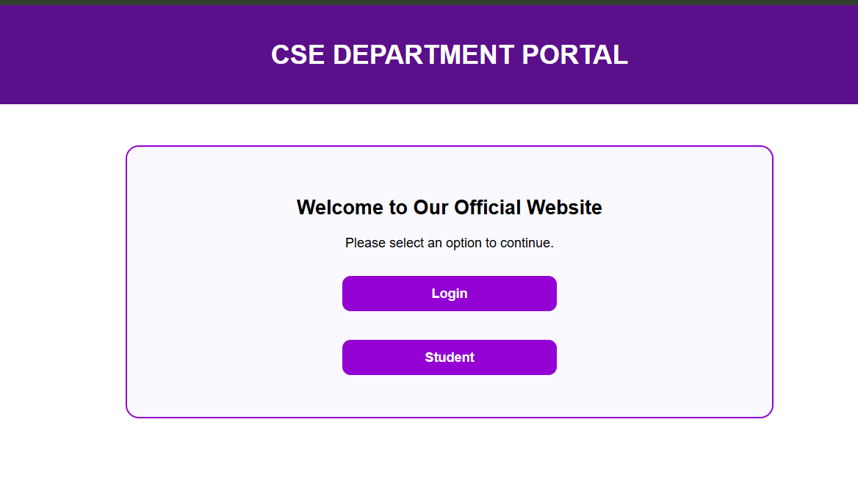
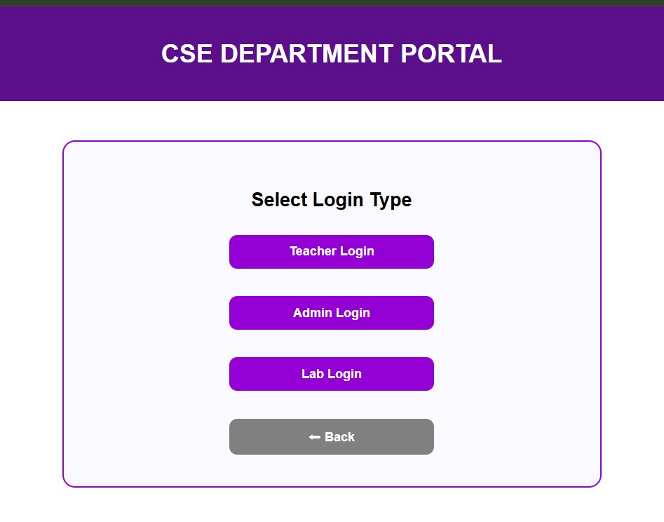
Result & Discussion (till date)
Role-Based Access: Ensures data security by granting access based on user roles.

Slide 12
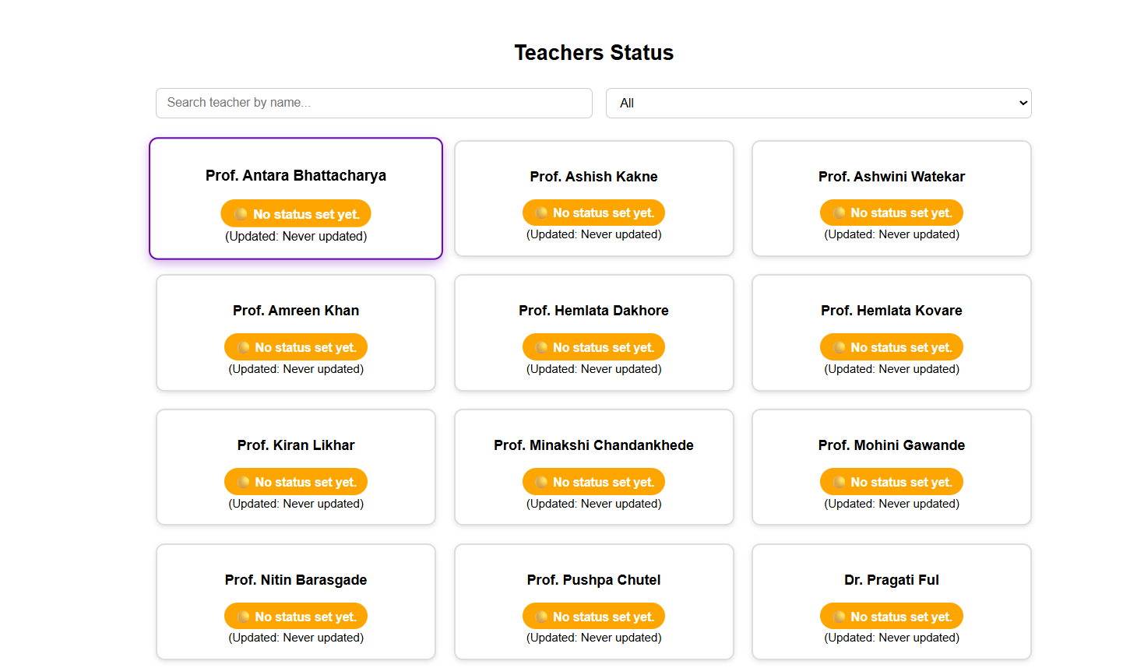
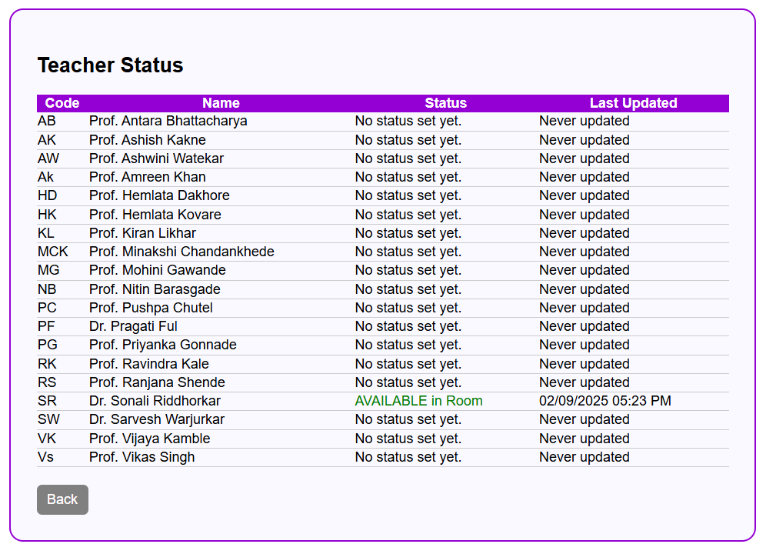
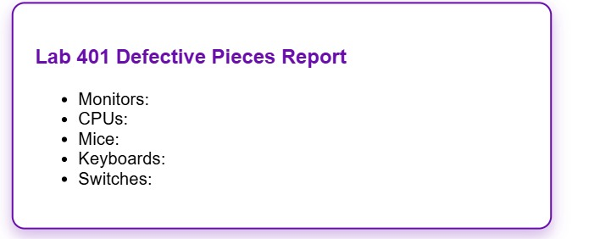
Result & Discussion (till date)
Real-time Monitoring: Provides live updates and dashboards for ongoing tasks and performance.

Slide 13
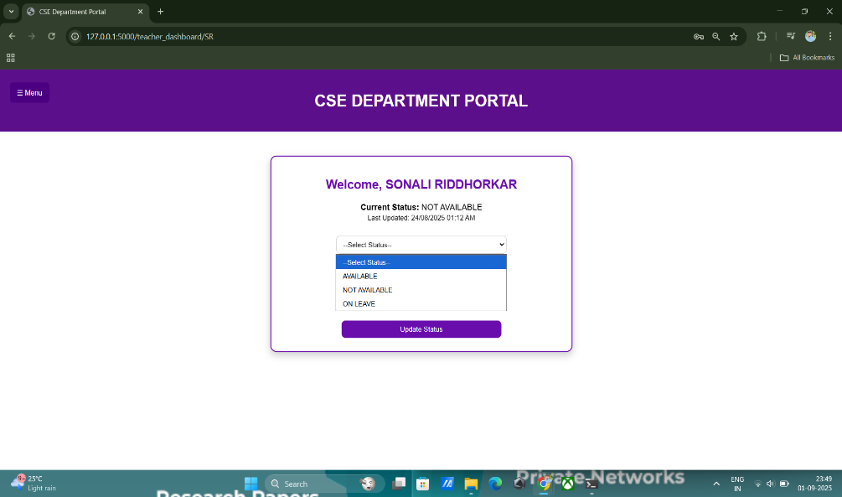
Result & Discussion (till date)
LOGIN & INTERFACE

Slide 14
Result & Discussion (till date)
Performance Tracking: Tracks departmental progress against predefined goals or KPIs
Automated Reports: Generates timely reports for audits, reviews, and strategic planning.

Slide 15
Work – Plan
Months Activities | JUN’25 | JULY’25 | AUG’25 | SEPT’25 | OCT’25
Literature Reviews | √ | √
Component Identification & Selection/ Study |  | √
Designing/Problem analysis (if any) |  | √ | √
Experimental Analysis (if any) |  | √ | √ | √
Testing and Debugging |  | √ | √ | √
Preparation of Project Report |  |  | √ | √
Project Report/Poster Submission |  |  |  |  | √

Slide 16
References
Title: A Web-Based “Department Management System” for Academic Institutions
Authors: Kulkarni, R., Shelke, A., Mane, R., Kulkarni, S., & Kulkarni, D. P.
Journal: International Journal of Advanced Engineering Research and Science (IJAERS)
Volume/Issue: 11(5), Pages 42–44
Published: May 2024
DOI: https://dx.doi.org/10.22161/ijaers.115.6
Summary:
A web-based system designed for academic departments to manage student and staff activities, reduce paperwork, and enhance accessibility of information.

Slide 17
References
Sajithabanu, S., Asrin Mahmootha, A., Aysha Banu, B., Mohamed Hisbullah, S., Mohamed, J., Nadeem, S., & Omarsha, S. (2025). Intelligent College Management System with Real‑Time Monitoring and Visual Analytics. Journal of Data Mining and Management, 10(2), 13–20. https://doi.org/10.46610/JODMM.2025.v10i02.002
Kulkarni, R., Shelke, A., Mane, R., Kulkarni, S., & Kulkarni, D. P. (2024). A web-based “Department Management System” for academic institutions. International Journal of Advanced Engineering Research and Science (IJAERS), 11(5), 42–44. https://dx.doi.org/10.22161/ijaers.115.6
V. Patel, S. Bhagwat, S. Ashtikar, and S. Kumbhare, "College Management System for College," International Research Journal of Modernization in Engineering Technology and Science (IRJMETS), [Online]. Available: https://www.irjmets.com
Ansari, Irshad & Mozammil, Kaynat & Kaif, Md & Sayed, Md & Khan, Md & Rasheed, Md & Ansari, Farah & Riaz, Mohd. (2024). College Management System. INTERANTIONAL JOURNAL OF SCIENTIFIC RESEARCH IN ENGINEERING AND MANAGEMENT. 08. 1-9. 10.55041/IJSREM40280.
Gupta, M., & Kate, V. (2023). Enhancing College Management Systems through Predictive Analytics. CSIT Department, Acropolis Institute of Technology and Research, Indore. International Journal of Computer Applications, 185(7), 45–52.
Jain, Rohit, Aman Modi, Ishan Kashyap, Prof. Vandana Kate, and Prof. Rachana Bahrawat. “Intranet College Management System: Attendance, Placement, Student–Faculty Interaction.” International Journal of Research Publication and Reviews, 2023, IJRPR, www.ijrpr.com.
S. Chakraborty, V. Prabhas, Ch. Prathamesh, A. Prathyusha Reddy, G. Pravallika, K. Pravallika, and G. Preetham Reddy, “Automated Smart Surveillance and Guidance for the Campuses,” IOSR Journal of Computer Engineering, vol. 25, no. 4, Ser. I, pp. 46–50, Jul.–Aug. 2023, doi: 10.9790/0661‑2504014649. scholar.google.co.instudocu.com+2iosrjournals.org+2iosrjournals.org+2
Amali, Lanto Ningrayati, Muhammad Rifai Katili, Sitti Suhada, and Tri Alfandra Labuga. “Business Process Monitoring System in Supporting Information Technology Governance.” Bulletin of Electrical Engineering and Informatics (BEEI), Oct. 2021.

Slide 18
Thank you !
Nagpur | Pune | Jalgaon | Amravati | Pandhurna | Bhandara

